Slide 1
Parking Lot Monitoring System
Regulo Garza, Gabriel Laboy, Kester Nucum, Genevieve Schreiber, Aaron Wilhite

Slide 2
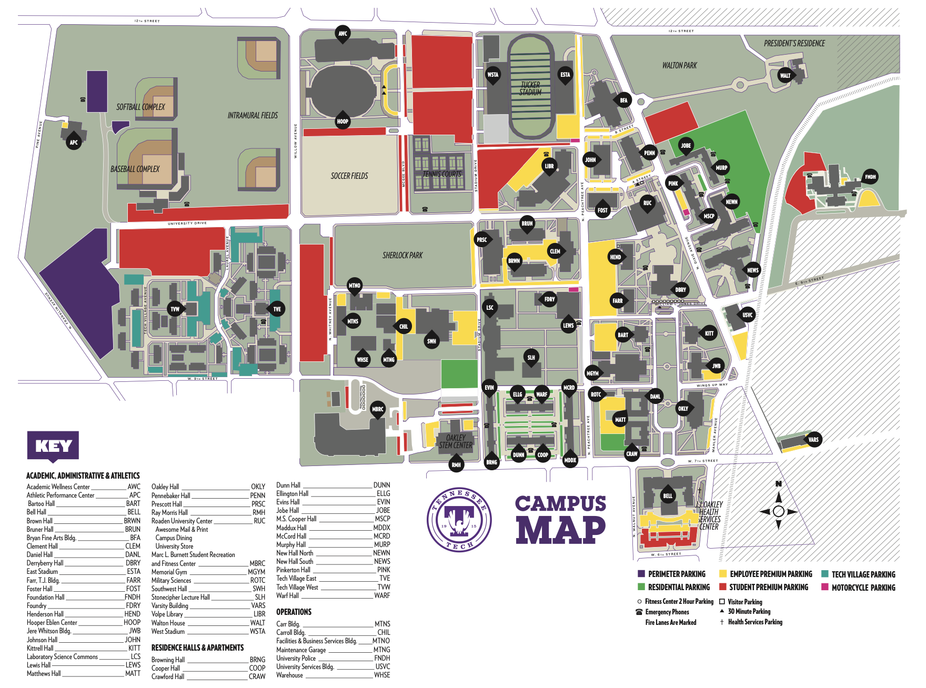
Tennessee Tech’s “Parking Problem”
Students want close parking spots
These closer red lots fill up quickly
Students waste time finding spots
Notes:
I can admit from personal experience that as a student, I want to park as close to my buildings as possible, even though I know walking is good for me. However, this want is not only shared by me but by hundreds of students every day. Therefore, the red parking spots that are closer to the center of campus, such as the library lot, the Pennebaker Hall lot, and the Bell Hall lot, fill up very quickly, and you’d think that we’d know this and decide to park in lots on the outskirts of campus, but we hold onto the little hope that there is an available spot magically appears. However, if there isn’t any, then precious minutes to get to class are wasted, potentially causing tardiness and frustration. Therefore, our project, a parking monitoring system, aims to assist students to know the availability of spots in lots across campus.

Slide 3
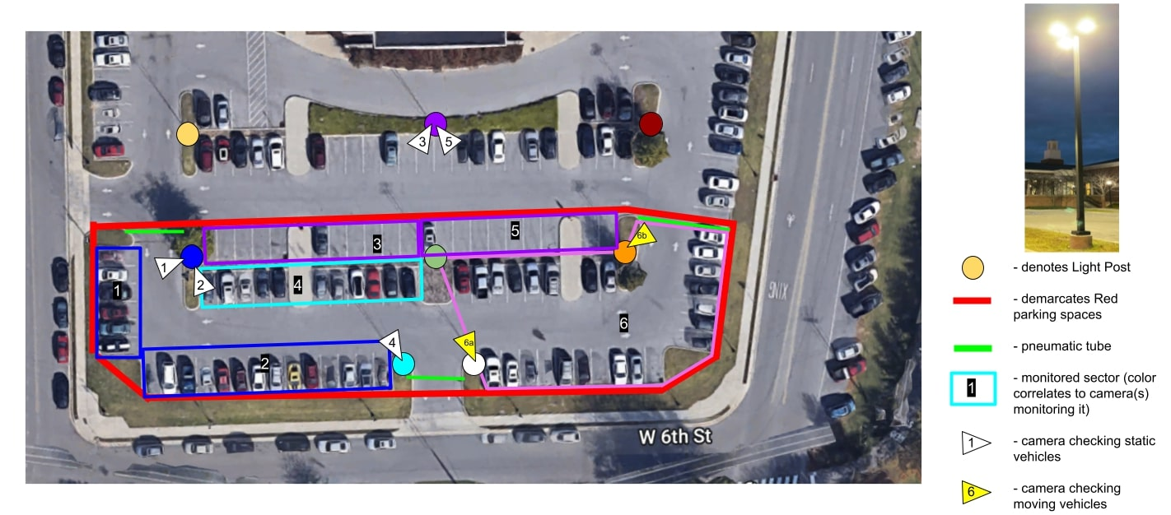
Vision for System in Bell Hall Lot
Notes:
We originally intended to implement an entire seven-camera system on the Bell Hall lot.
Parking lot -> divided into sectors, each sector with a different type of tracking (either static tracking or dynamic tracking), reason for sectors is we wanted to avoid cars from being too far away and not having enough pixels to be properly seen by the cameras and AI algorithm
-> For lots in which a light post has an unobstructed view of spots and cars in the frame are close enough to have a sufficient pixel resolution, these sectors will be statically tracked. Static tracking just counts the number of cars that are parked.
-> For lots in which a light post have an obstructed view of spots and are too far away from certain spots, these sectors will be dynamically tracked. Dynamic tracking counts the cars that enter or exit the entrance. Direction will be noted in order to determine this.
Cameras -> will be installed up high on light posts unless the light post is covered by a tree (6b). These will be powered via solar power, and they will be adequately cased for weatherproofing, vandalism and bird proofing, and simply bracing the elements. They will send image frames wirelessly (via Wi-Fi) to a server for image processing.
Server -> House the AI algorithms that process images to obtain the number of cars from the various video feeds, which are received wirelessly. Images and videos will not be stored. Server will send this data to a remote database connected to a mobile application that students can view before they head to campus as well as an outdoor sign, similar to those at an airport parking lot, that indicates the number of available spots as the students enter the lot.
We did originally design this system with pneumatic road tubes at entrances, as you can see, to validate the camera data. However, after a cost-benefit analysis, we removed this system since we would have to experimentally validate the accuracy of the cameras and image processing. More so, the dynamic tracking performs the same function as the road tubes.
Cost Benefit Analysis -> The secondary acquisition system's purpose is to act as the ground truth for the primary acquisition system. A ground truth system is one that acts as the reference point to another system. The reference point we are comparing in our system is the “vehicle count” inside the lot. Having said this we would still had to have done validation tests on the camera “vehicle count” data. The price for implementing three pneumatic road tube systems would be roughly 650.00.

Slide 4
Stakeholder Input and Constraints
Stakeholders
Parking and Transportation
University Police
Facilities
Overarching Constraints
No obstruction of spaces/traffic
No storage of images/videos
Operational between 7:30 a.m. to 4:30 p.m.

Slide 5
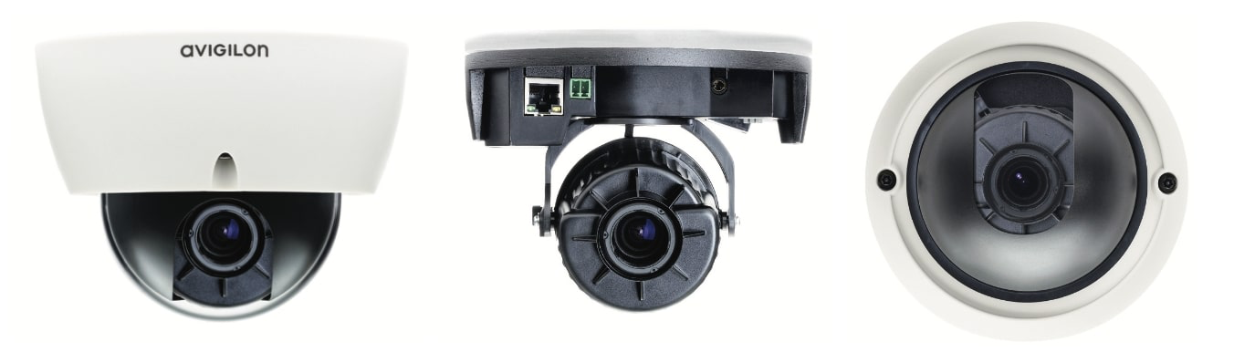
Cameras
Avigilon 2.0 Megapixel Day/Night H.265 HD Indoor Dome Cameras
Obtained from ITS
Frame Rate: 30 fps
Field of View: 98°
Supports ONVIF, RTSP
Notes:
It is very difficult to find cheap outdoor cameras that have little abstraction to obtain video footage (as in you can directly access footage without an intermediary software) and have a good field of view and a good resolution. These cameras would have cost us up to thousands of dollars.
ONVIF, RTSP - ONVIF is a standardized method to communicate to IP surveillance cameras with servers, etc. RTSP is a protocol that allows for video and audio streaming over a network. The camera should be able to support ONVIF, RTSP, or both. Contraints: IEEE 802.3af about POE, 100base-tx

Slide 6
Sign
LED strips used as seven-segment displays
Arduino Mega microcontroller
Serial communication with PC

Slide 7
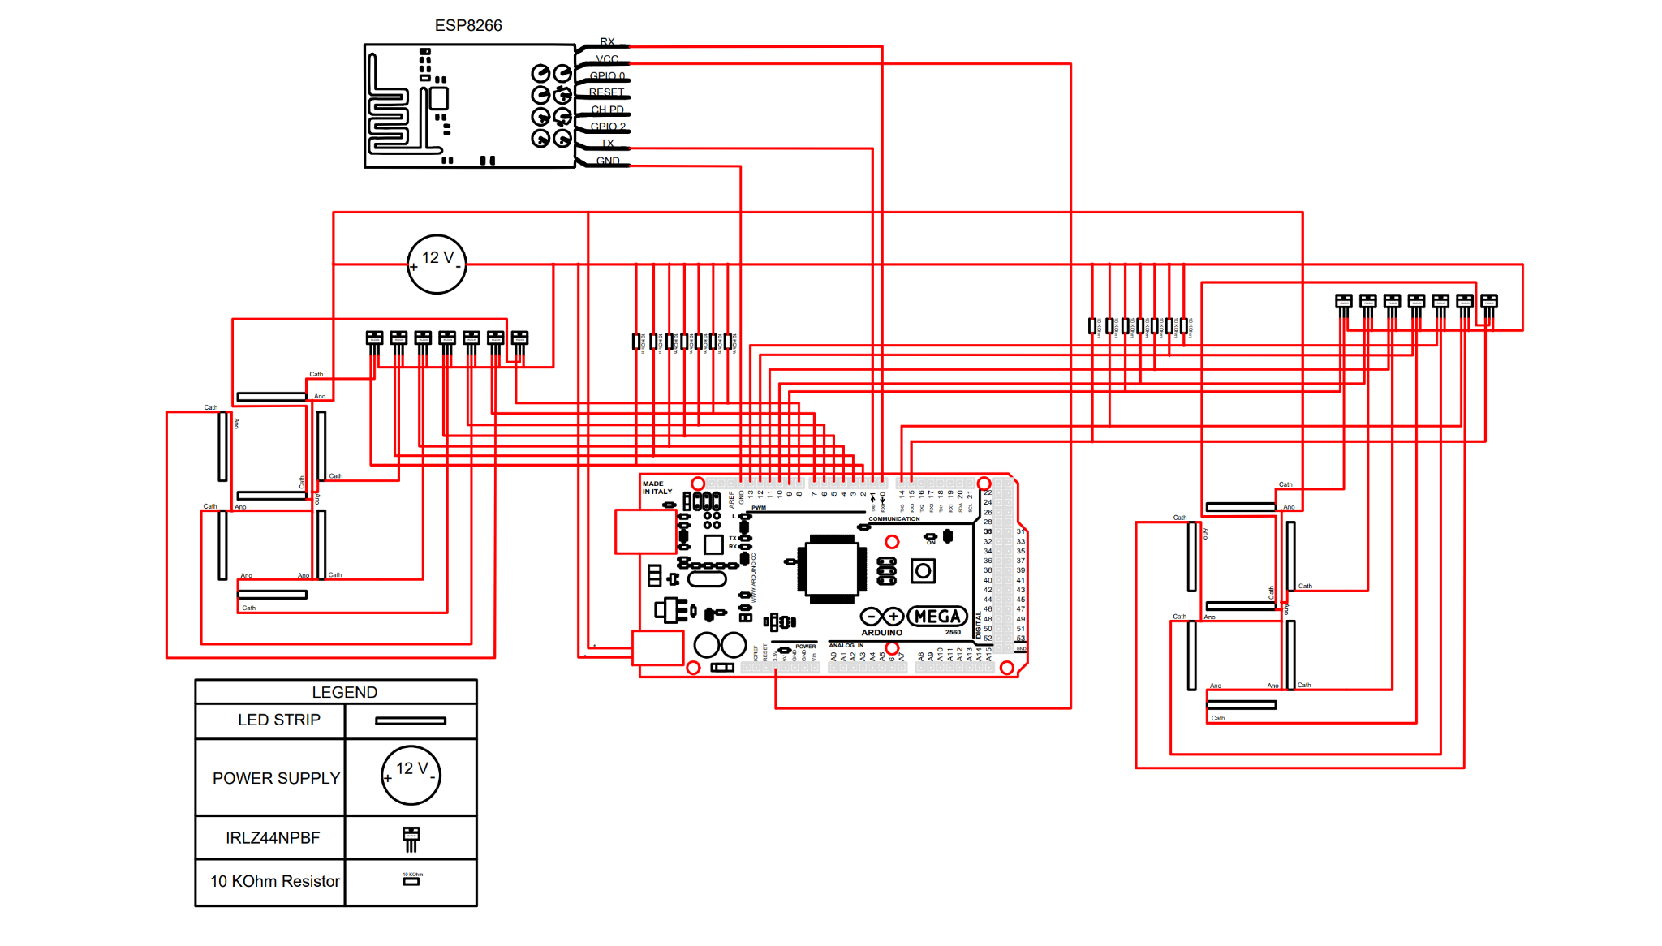
Sign Schematic

Slide 8
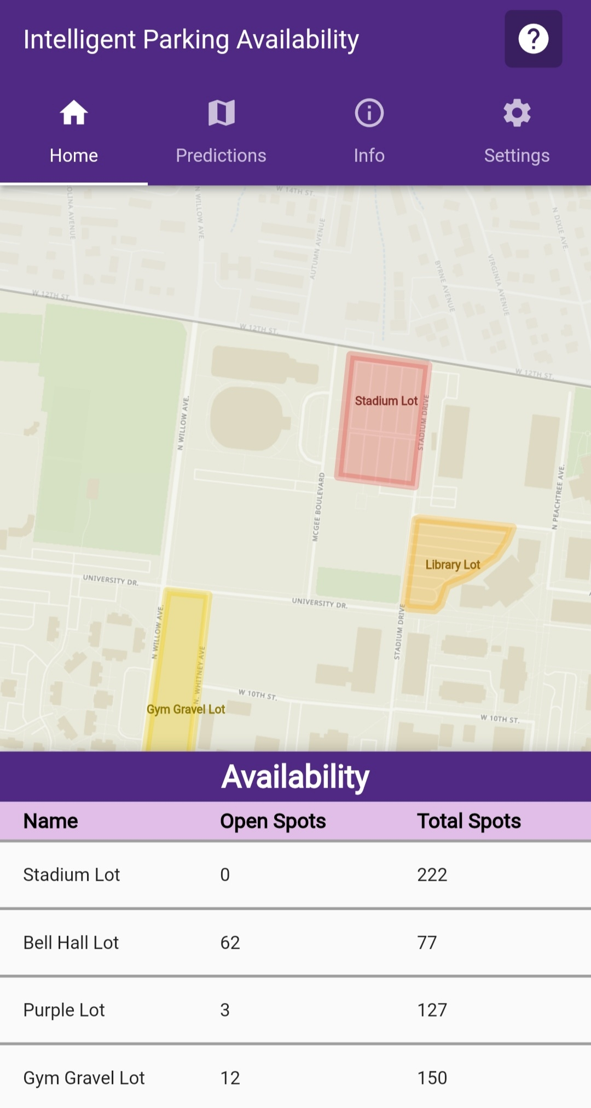
Mobile Application
Designed by CS Team
Display availability information from remote database
Google Firebase
Notes:
We provide the data to the remote database from the server

Slide 9
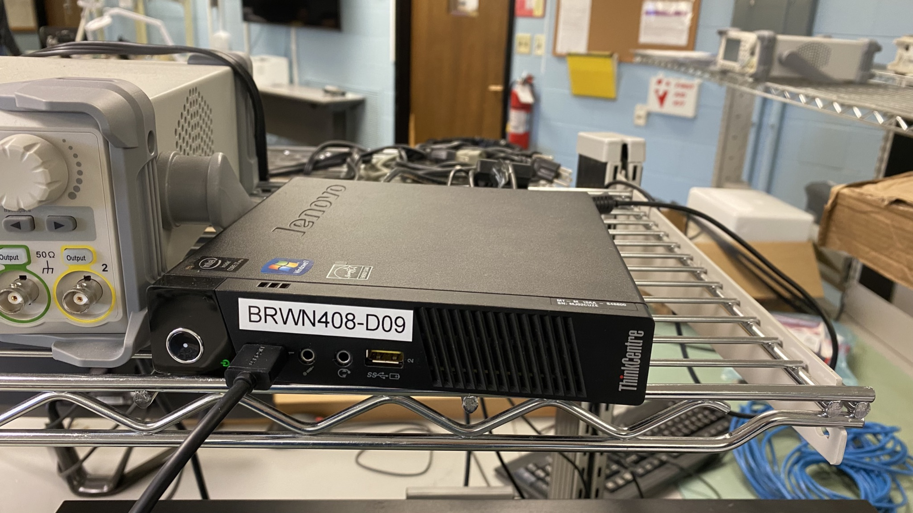
Server
Obtained from ITS
Communicates between cameras and database
Performs image processing
YOLOv3 algorithm
Interfaced with OpenCV
Notes:
We did design a server suited for the AI processing; however, because such as server would cost $800, we wanted to obtain a server to demonstrate functionality of the algorithms. The server was Linux.
YOLOv3 - real-time object detection algorithm, has very fast inference time if run on a NVIDIA GPU with CUDA cores, good accuracy and great for real-time applications. This was the one that the CS team was most familiar with as well. This was interfaced with OpenCV, which is a free and open-source computer vision library that allows for easy interfacing between the AI and the cameras.

Slide 10
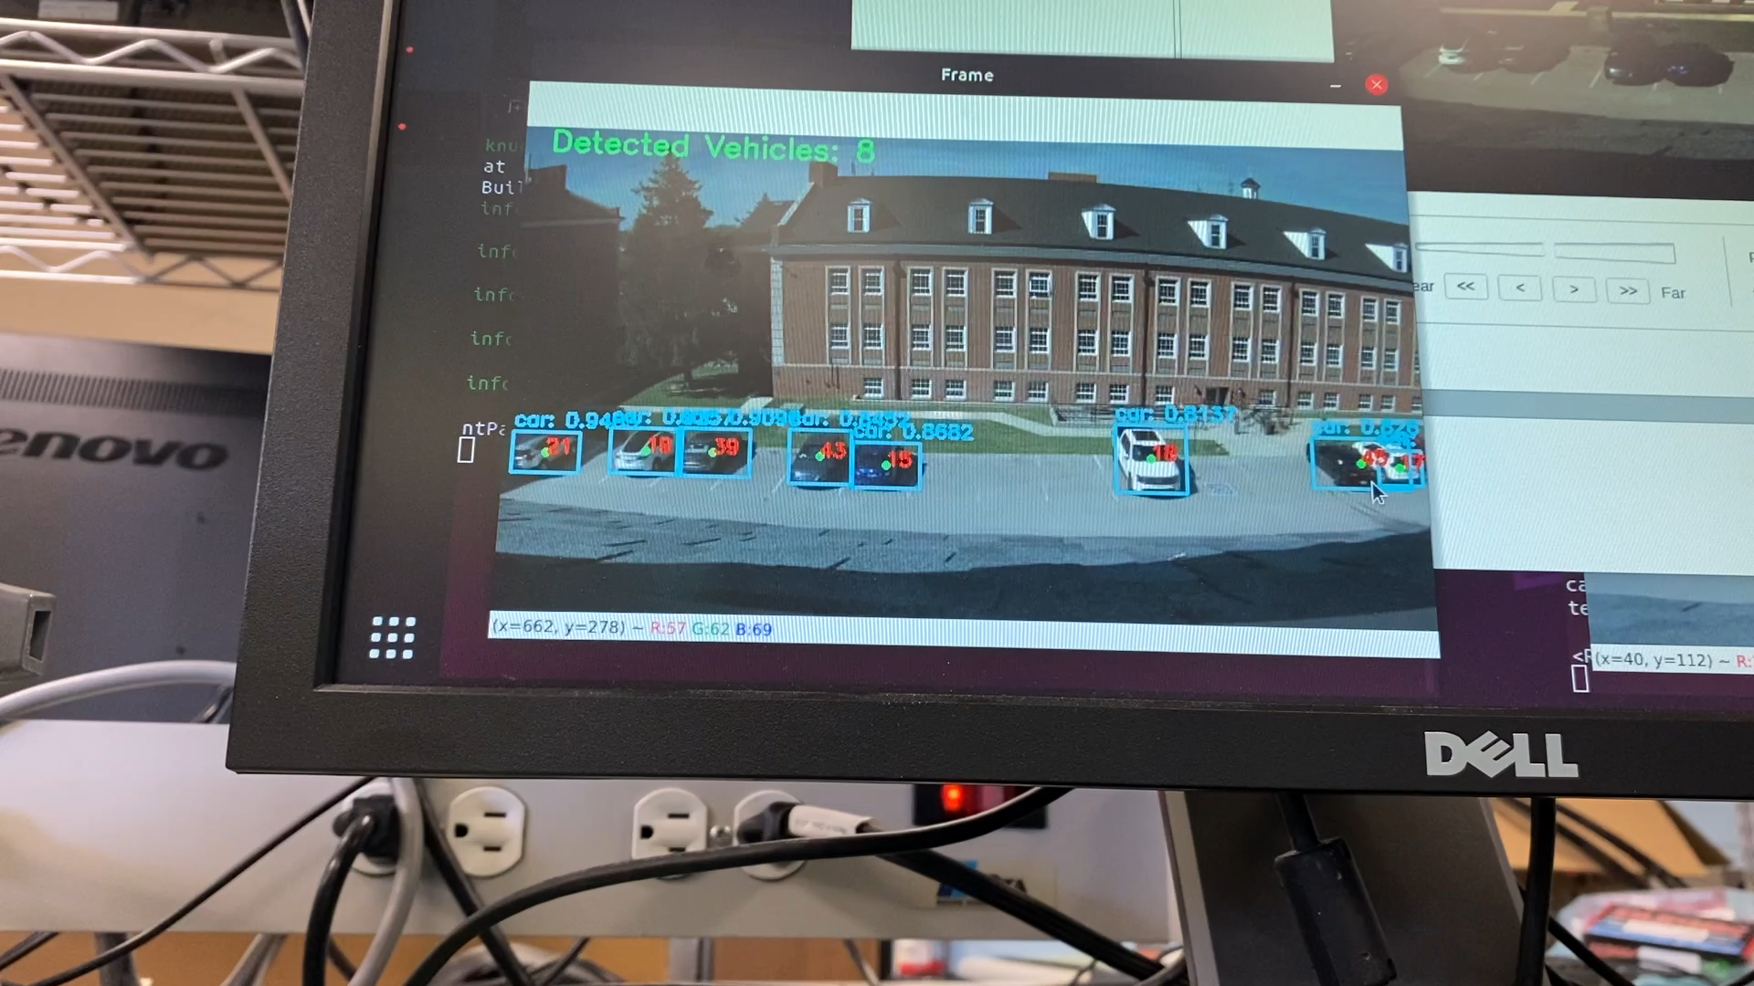
Static Tracking Model Demonstration

Slide 11
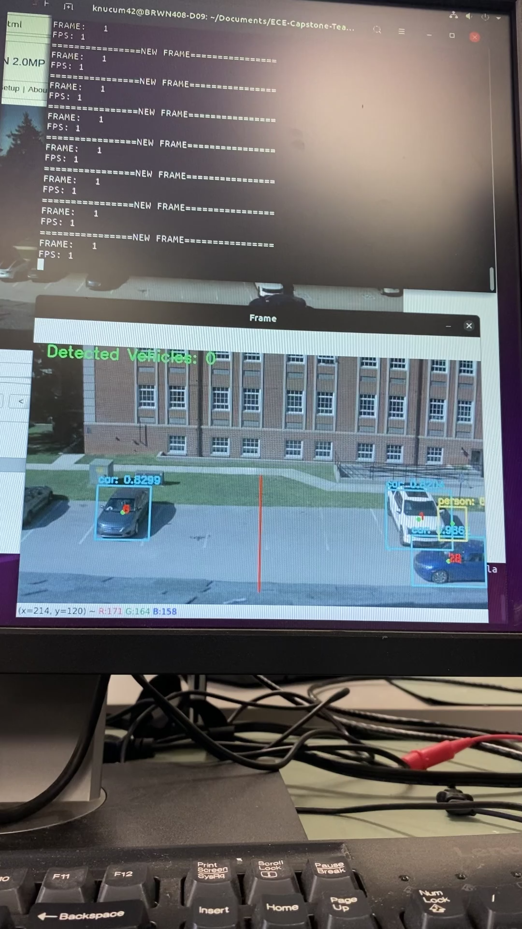
Dynamic Tracking Model Demonstration

Slide 12
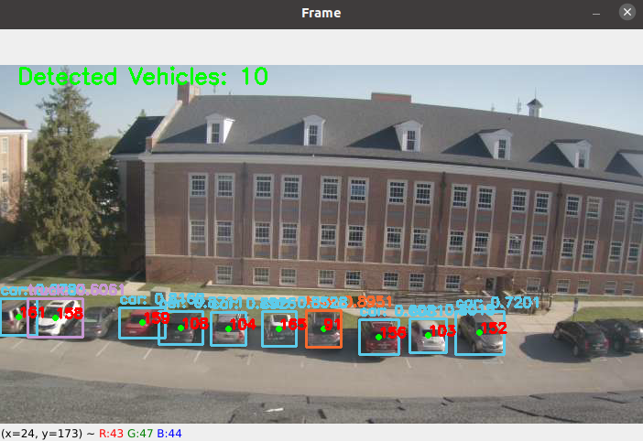
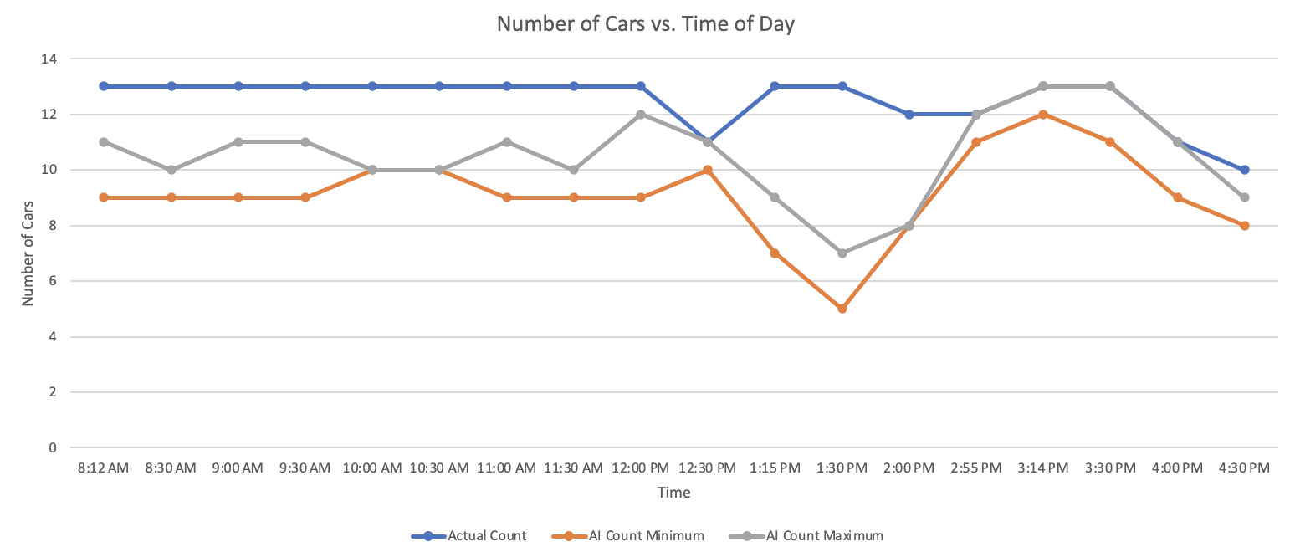
Static Tracking Model Results
Notes:
Static Tracking Model
More accurate during afternoon than morning or midday
More accurate in overcast conditions vs. clear conditions
Did not meet intended ±1 car accuracy
Dynamic Tracking
Can only detect cars crossing virtual line at < 3 mph

Slide 13
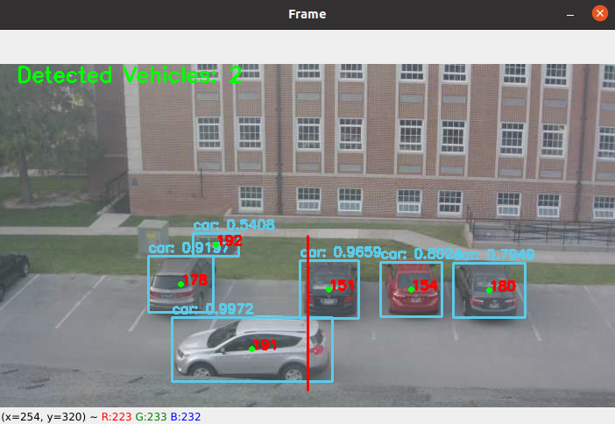
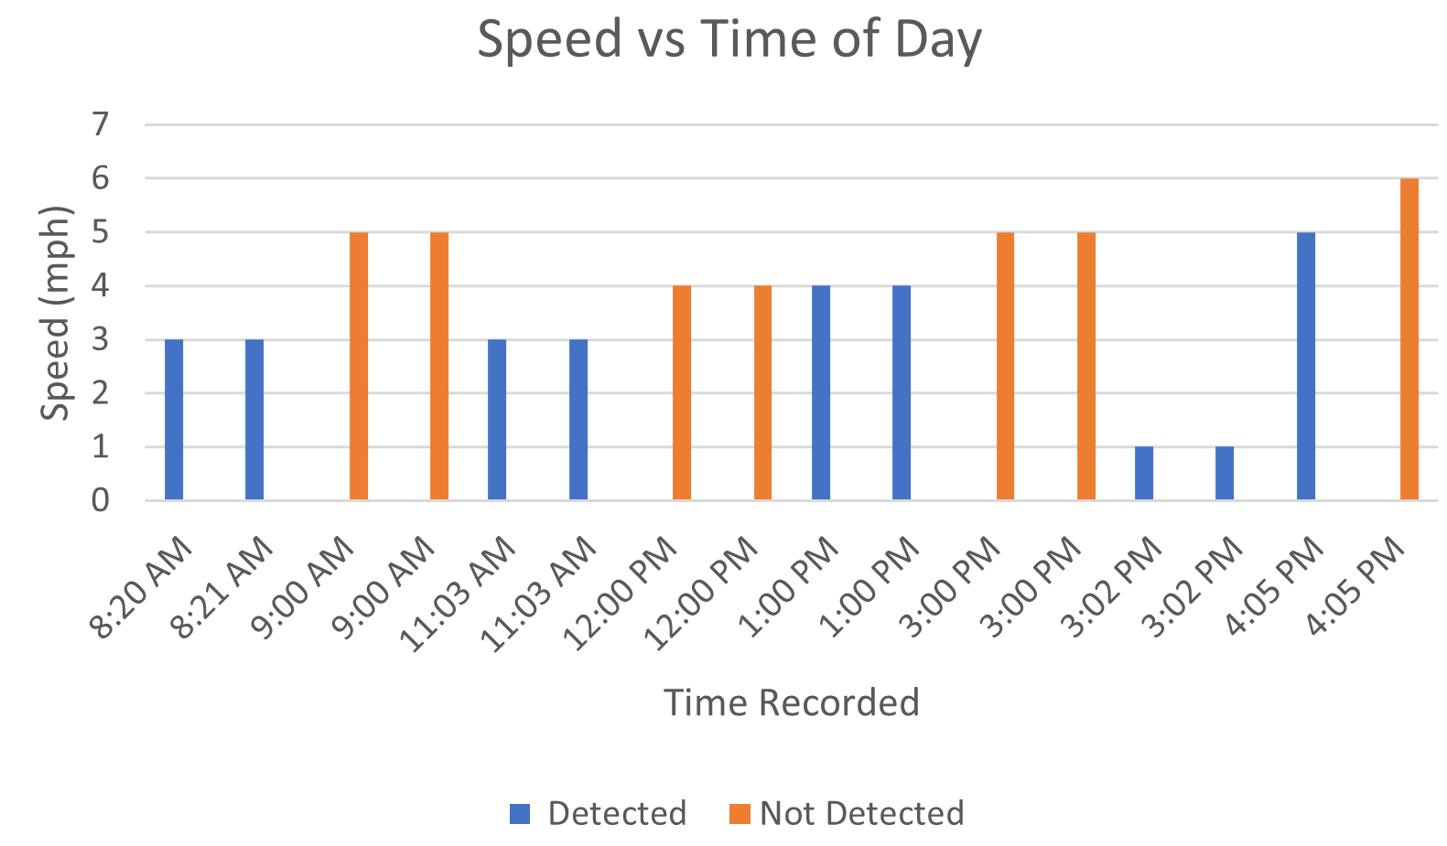
Dynamic Tracking Model Results
Notes:
Dynamic Tracking
Can only detect cars crossing virtual line at < 3 mph

Slide 14
Bill of Materials
Product | Part Number | Manufacturer | Quantity | Price
Arduino Mega 2560 REV3 | A000067 | Arduino | 1 | $48.40
LED Light Strips | 4P-MDLEST0011-R | Keiurot | 4 | $50.76
IRLZ44NPBF | IRLZ44NPBF | Infineon Technologies | 14 | $21.28
Mounting Tape | 52427008053 | Gorilla | 1 | $12.24
Custom 18” x 24” Aluminum Sign | K-3428-BK | RoadTrafficSigns | 1 | $37.75
Post Attachment Kit | K-KIT2 | RoadTrafficSigns | 1 | $1.87
Transparent Duct Tape | GP-ClrDctPrnt | Gaffer Power | 1 | $12.88
Cameras | 2.0-H3-D1 | Avigilon | 2 | Provided
 |  | Total | 25 | $185.18
Notes:
13:15-14
Due to the lended server and gifted cameras, all billed items only relate to the sign. Descoping of the pneumatic tubes and no ordering of server components still saved a substantial amount of money.
We contacted Avigilon before being gifted the cameras. They quoted us The 2.0C-H6M-D1-IR has an MSRP price of $ 441.00.

Slide 15
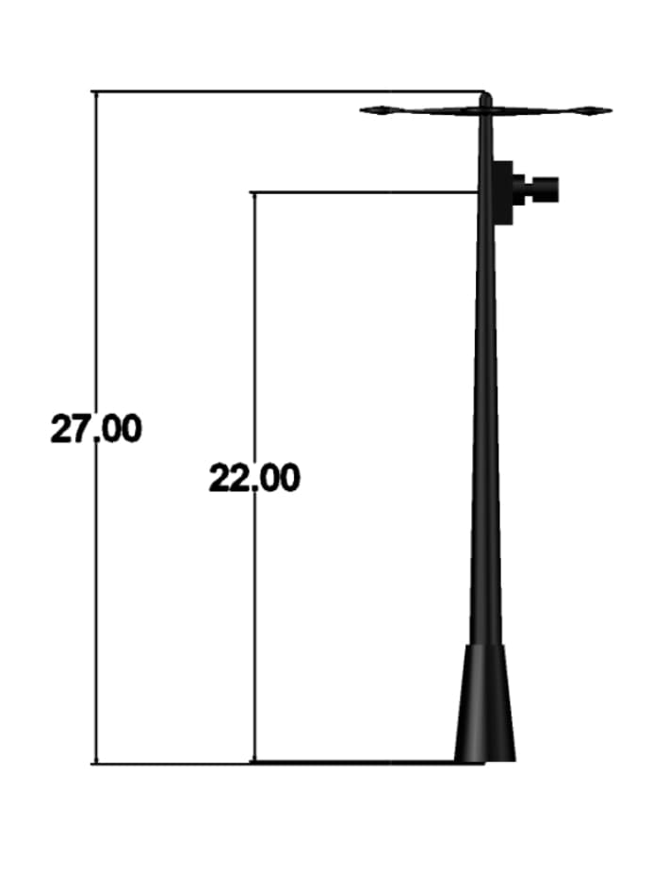
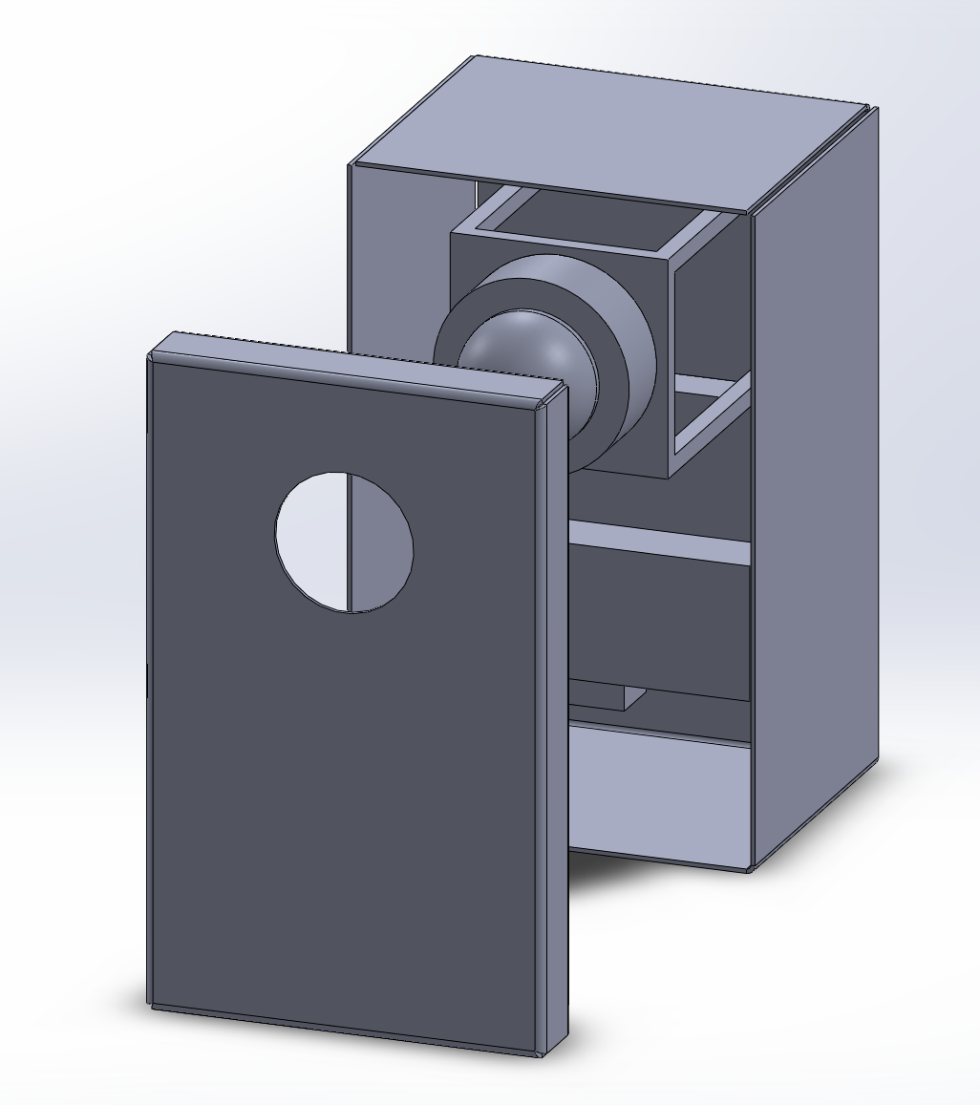
Future Work: Implement System Outdoors
Notes:
14-15
Outdoor Implementation for future iterations
Upgrade server to run CUDA-enabled YOLOv3 on NVIDIA GPU
Weatherproof and electrically secure sign for outdoor use
Implement wireless communication between cameras, server, sign, and remote database
Design a solar-based energy source for cameras and sign
Install safety casing over cameras
Ensure that these cameras require as little maintenance as possible

